Slide 1
Report
for Oct 2021 – 1st MP
BFX – UA300
Date : 22-Oct-2021
Prepared by: Heng Ruan

Slide 2
Issue Description
21-Oct, ALT customer complain [BFX-UA300] Oct 2021 1st Mass production issue.
Overall inspection result => Fail (Waived, due to product launch schedule)
Defect Total:
•Critical
1. Booting fail * 1pcs - Defect rate : 0.13%
2. FFC defect*2pcs
3. Ferrite Core broken about 60%
•Major
1. Inner sheet missing*1pcs
2. Side deco plate NG about 40%
3. Side deco plate Missing * 1pcs
•Minor
1. Factory stuff inside the product * 3pcs
2. Side deco plate poor attachment about 60%
3. KC label attachment NG*2pcs

Slide 3
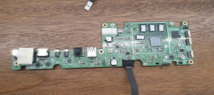
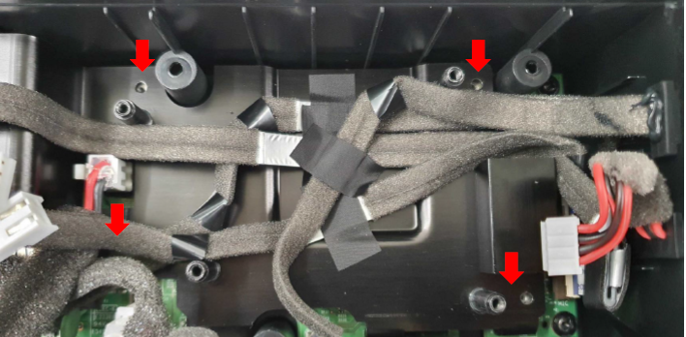
1. Booting fail & No Screw fastening inside
Issue Description | Root Cause | Actions | Owner | Due Date | Status
Symptom: Booting fail * Type: Critical Defect unit Q’ty : 1pcs / 756pcs Defect rate : 0.13% SKB SN: 2149695001202109000160 | ALT initial review •Booting is fail It may HW defect •No boot after SPI booting and eMMC update directly. •Booting log : Link init cpupll 800MHz init mempll 2400MHz init 3GB DDR, lib version r63074 hw_init done custom table done asking BCM to load miniloader. bcm_load_next_img error!init cpupll 800MHz •Also, this SET is no screw fastening inside | - Waiting sample for further analysis | PE-Loc TE-Allan | TBD TBD

Slide 4
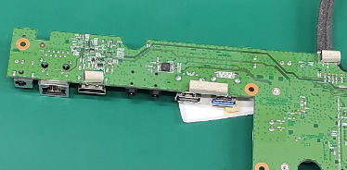
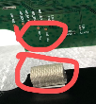
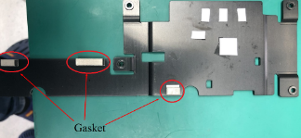
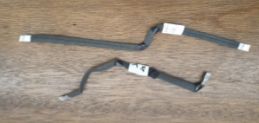
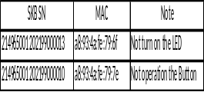
2. FFC cabledefect - No turn on the LED, No button operation
Issue Description | Root Cause | Actions | Owner | Due Date | Status
Symptom : No turn on the LED, No button operation Type: Critical Defect unit Q’ty : 2pcs / 756pcs Defect rate : 0.26% | Check production data of products detect two product was been rework cause gasket making AMP_SDA & GND short issue. 2. Check Log test , two product pass all test station => LED and Button function still working normal before shipping. Summary: - The issue could be happen when FFC cable folding and release when rework and vibrate of product during shipping time cause damage to cable wire. | Change gasket paste location to edge of PCBA to avoid AMP_SDA & GND short. Change gasket marking on heat spreader to prevent AMP_SDA & GND short . | RD: Tom Lee | TBD

Slide 5
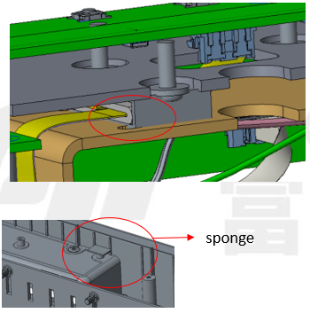
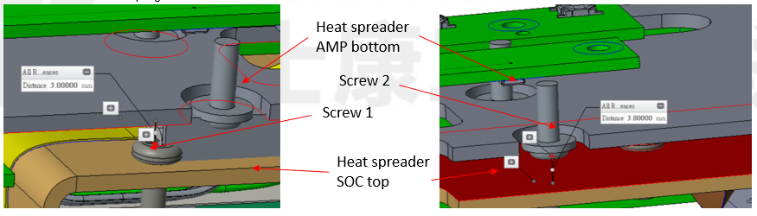
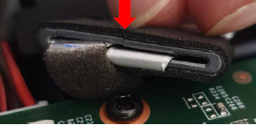
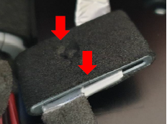
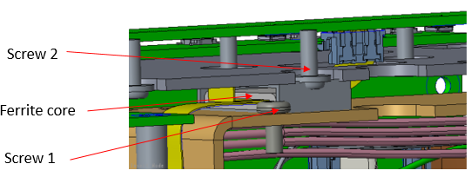
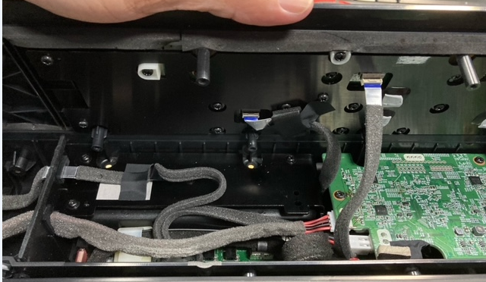
3. Ferrite Core broken after assembly
Issue Description | Root Cause | Actions | Owner | Due Date | Status
Symptom : Ferrite Core broken after assembly Type: Critical Defect unit Q’ty : Not counted Defect rate : about 60% | 1. The gap between Heat spreader AMP bottom and Heat spreader SOC top is 5mm, and the thickness of ferrite core plus sponge is 5mm. The screw1 and screw2 will interfere with sponge. 2. Ferrite core interferes only with screw2 After locking top cover and bottom cover 6 times, the ferrite core is still undamaged. 3. Interference between ferrite core and screw1 & screw2 4. After locking top cover and bottom cover, the ferrite core is damaged | 1. Remove the screw1 when using a short FFC cable, and paste a sponge(10*10*1mm) on the screw boss to avoid audible noise. 2. Lengthen FFC cable, and fix ferrite core on top cover with 3M tape to avoid screws conflict. | RD: Jim Chen Sean Chiang | 2nd MP

Slide 6
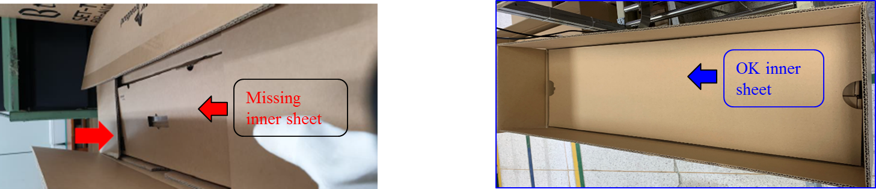
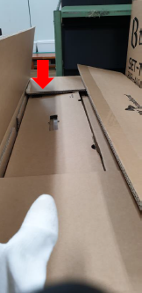

4. Inner sheet missing on the carton box
Issue Description | Root Cause | Actions | Owner | Due Date | Status
Inner sheet missing on the carton box Type: Minor Defect unit Q’ty : 1pcs / 189 carton •Defect rate : 0.52% •Box No : SKBUA321100046 | 1. in Packing CTN station, operator doing follow SOP define. But with defect carton, operator forgot put inner sheet into carton before close Carton Box. 2. After close and seal carton box there are only OBA station can check accessories inside but it’s only random check with sample rate C=0, AQL=0.4. | 1. Update NG picture to SOP for reminded OP at Packing station check inner sheet before close carton box. 2. Qualify inner sheet material for each pallet by 24pcs with each pallet in one time to prevent missing issue. 3. Increase OBA sample rate by C=0, AQL=0.25 4. Training OP by Quality alert customer high light inspection issue with K18 product. | IE: Heng PQE: Bien | Done 22-Aug

Slide 7
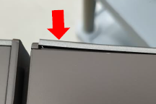
4. Side deco plate NG
Issue Description | Root Cause | Actions | Owner | Due Date | Status
Side deco plate NG Type: Major Defect unit Q’ty : Not counted Defect rate : about 40% | Waiting RD analysis and improved by next build. |  | RD: Jim Chen | TBD

Slide 8
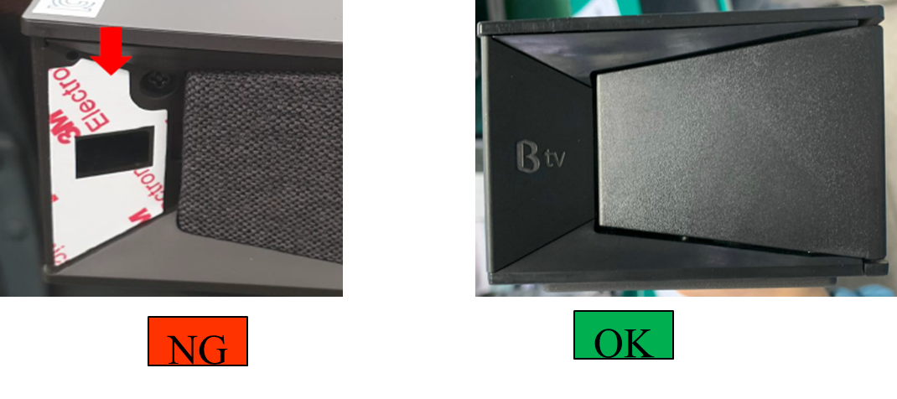
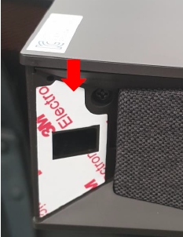

4. Side deco plate Missing
Issue Description | Root Cause | Actions | Owner | Due Date | Status
Side deco plate Missing Type: Major Defect unit Q’ty : 1pcs / 756pcs Defect rate : 0.13% SN: 214965001202109000061 | At Paste rubber shore & decoration station adding OP forget remove release linear and paste deco plate onto product ( SOP have define ). At VI station, OP no check carefully decoration before put product into gift box. After close gift box there are only OBA station can check accessories inside but it’s only random check with sample rate C=0, AQL=0.4. | 1. Add Side Deco plate checking is a CTQ item in SOP of rubber shore & decoration adding and VI station. 2. Increase OBA sample rate by C=0, AQL=0.25 3. Training all OP by Quality alert customer high light inspection issue with K18 product. | PQE: Bien IE: Hang PD: Van Anh | Done 22-Aug

Slide 9

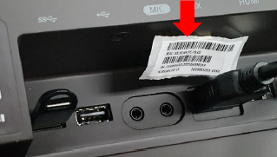
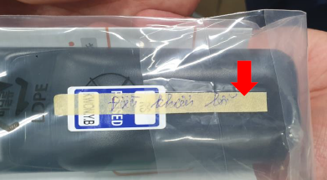
4. Factory stuff inside the product
Issue Description | Root Cause | Actions | Owner | Due Date | Status
Factory stuff inside the product Type: Minor 1pcs / 756pcs SET temp label on the rear side 2pcs / 756pcs Defect rate : 0.39% | At printer device label station , after scan MAC on draft label to purpose of device housing label printing, operator must remover draft label ( just factory control and use for function test before links product with KSB SN). But operator was forget remover this label and take pass product to next station. 2. OP at Visual Inspection check cosmetic product was not defect and remove this label 3. OP did memo on RCU have remark “ RCU NG ” cause OP defect visual inspection RCU defect PE bag broken. So OP write remark for line leader know. But he put NG and OK accessory together in same box. In next shift OP doing at this station don’t know and put this RCU normal user. 4. After close gift box there are only OBA station can check accessories inside but it’s only random check with sample rate C=0, AQL=0.4. | 1. Training all OP by Quality alert customer high light inspection issue with K18 product. 2. Add an NG material area where all NG material must be put on after separate out of production line. 3. Increase OBA sample rate by C=0, AQL=0.25 | PQE: Bien IE: Hang PD: Van Anh | Done 22-Aug

Slide 10
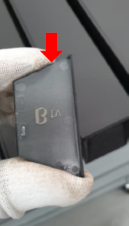
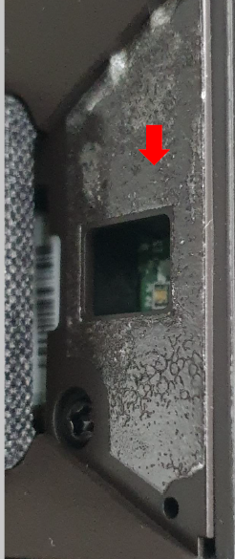
4. Side deco plate poor attachment
Issue Description | Root Cause | Actions | Owner | Due Date | Status
Side deco plate poor attachment Type: Minor Defect unit Q’ty : Not counted Defect rate : about 40% | Co-work with RD for find out root cause and corrective action for next building. |  | RD: Jim Chen | TBD

Slide 11
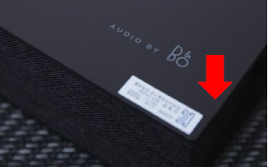
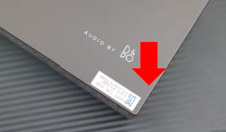

4. KC label attachment NG
Issue Description | Root Cause | Actions | Owner | Due Date | Status
KC label attachment NG Type: Minor Defect unit Q’ty : 2pcs / 756pcs Defect rate : 0.26% | 1. SOP define KC label adding method by using fixture but in this case, operator paste KC label manually without label fixture. 2. VI operator was not detect the defect before put product into foam bag | 1. Add NG picture to SOP of PACKING and VI station, 2. SOP define KC label adding method must be 100% use label fixture. 3. Training all OP by Quality alert customer high light inspection issue with K18 product. | PQE: Bien IE: Hang PD: Van Anh | Done 22-Aug
NG

